Slide 1


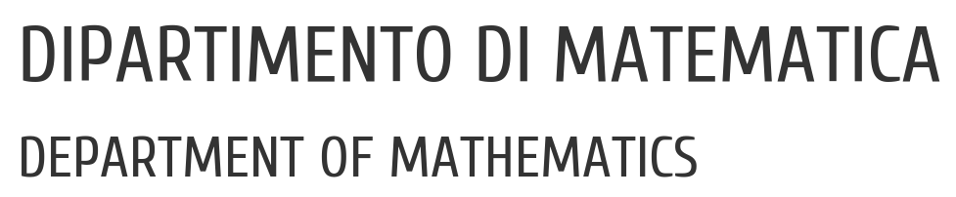

UNIVERSITY OF PADUA
UNIVERSITA’ DEGLI STUDI DI PADOVA
Evaluation and analysis of
anti-repackaging techniques robustness in an Android virtual environment
Candidato:
Claudio Rimensi (matr. 1207423)
22 Luglio 2021
Relatore: Correlatore: Prof. Mauro Conti Dr.ssa Eleonora Losiouk
Corso di Laurea Magistrale in Informatica

Slide 2

Android: Introduction
Android is the most widely used mobile operating system today[1]
Android is open source
Rich SDK
Ability to use and choose third-party applications
1. https://it.wikipedia.org/wiki/Android
Evaluation and analysis of anti-repackaging techniques robustness in an Android virtual environment
Claudio Rimensi
2 di 15

Slide 3

Android is too open source
Android's open nature allows the development of malicious apps
The goal of malware authors is the possession of confidential user data
Sandboxing was used to protect user data to avoid any unauthorized tampering
However, users may want to run multiple instances of an application on the mobile device
Evaluation and analysis of anti-repackaging techniques robustness in an Android virtual environment
Claudio Rimensi
3 di 15

Slide 4
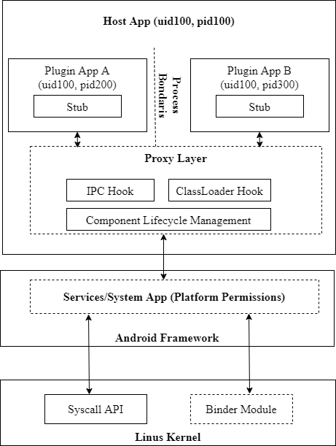
An Attractive solution: Virtualization
Since 2015, app virtualization emerges as a new technique that can load arbitrary third party APKs without installation.
Android Virtualization come from Dynamic Code Loading and Dynamic Proxy Hooking
The main frameworks used are VirtualAPP [2] and DroidPlugin [3]
[2] https://github.com/asLody/VirtualApp
[3] https://github.com/DroidPluginTeam/DroidPlugin
Evaluation and analysis of anti-repackaging techniques robustness in an Android virtual environment
Claudio Rimensi
4 di 15

Slide 5
Legitimate Usage of Android Virtualization
Evaluation and analysis of anti-repackaging techniques robustness in an Android virtual environment
Claudio Rimensi
5 di 15

Slide 6

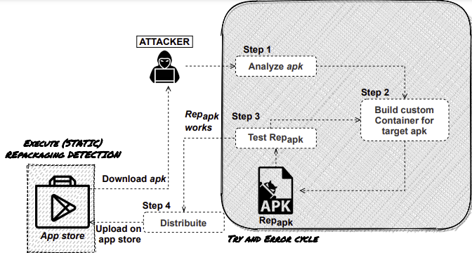
Risks using Virtualization
Share UID
Excessive Permission
Predefined Stub Component
Component LifeCycle
This kind of model leads to the creation of malicious apps
Application repackaging is one of the top ten mobile risks (OWASP 2016: https://owasp.org/www-project-mobile-top-10/)
Evaluation and analysis of anti-repackaging techniques robustness in an Android virtual environment
Claudio Rimensi
6 di 15

Slide 7
Demistify Virtualization and Anti-Repackaging Mechanism
T. Luo, C. Zheng, Z. Xu, and X. Ouyang. (2017). Anti-Plugin: Don't let your app play as an Android plugin. Proceedings of Blackhat Asia.
Luman Shi, Jianming Fu, Zhengwei Guo, and Jiang Ming. 2019. "Jekyll and Hyde" is Risky: Shared-Everything Threat Mitigation in Dual-Instance Apps. In Proceedings of the 17th Annual International Conference on Mobile Systems, Applications, and Services (MobiSys '19). Association for Computing Machinery, New York, NY, USA, 222235.
Luman Shi, Jiang Ming, Jianming Fu, Guojun Peng, Dongpeng Xu, Kun Gao, and Xuanchen Pan. 2020. VAHunt: Warding Off New Repackaged Android Malware in App-Virtualization's Clothing. In Proceedings of the 2020 ACM SIGSAC Conference on Computer and Communications Security (CCS '20). Association for Computing Machinery, New York, NY, USA, 535–549. DOI:https://doi.org/10.1145/3372297.3423341
Repackaging detection: Repackaging detection focuses on recognizing repackaged apps in app stores or on user’s devices, with the aim of limiting the spread of the repackaged app
Anti-repackaging: Anti-Repackaging aims to protect an app from being successfully repackaged. As opposed to repackaging detection, anti-repackaging is applied by the developer to the app code before building the apk and aims to make any repackaged version of the same app crash
Evaluation and analysis of anti-repackaging techniques robustness in an Android virtual environment
Claudio Rimensi
7 di 15

Slide 8
A Novel solution: MARVEL
MAIN ISSUES:
Preventing an attacker from being able to statically analyze an app to completely reconstruct both code and protection controls
Prevent an app from running in a malicious container that bypasses traditional Anti-Tampering (AT) controls
Detecting an intermediate malicious container that runs in the container’s virtual environment and executes a plugin
SOLUTION:
MARVEL (Mobile-app Anti-Repackaging for Virtual Environments Locking)
Evaluation and analysis of anti-repackaging techniques robustness in an Android virtual environment
Claudio Rimensi
8 di 15

Slide 9
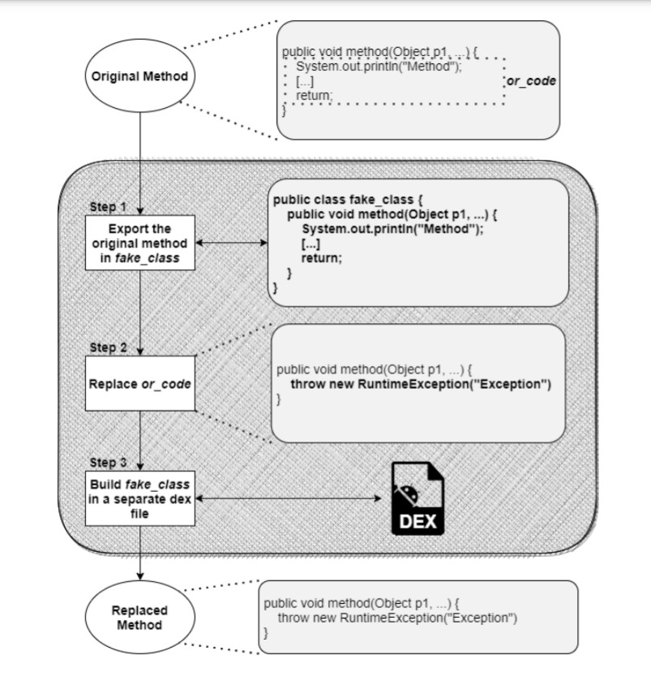
A Novel solution: MARVEL
MARVEL protects the application through 3 approaches:
Code Splitting
Base IAT (Interconnected Anti-Tampering Controls)
IAT with encryption
Evaluation and analysis of anti-repackaging techniques robustness in an Android virtual environment
Claudio Rimensi
9 di 15

Slide 10
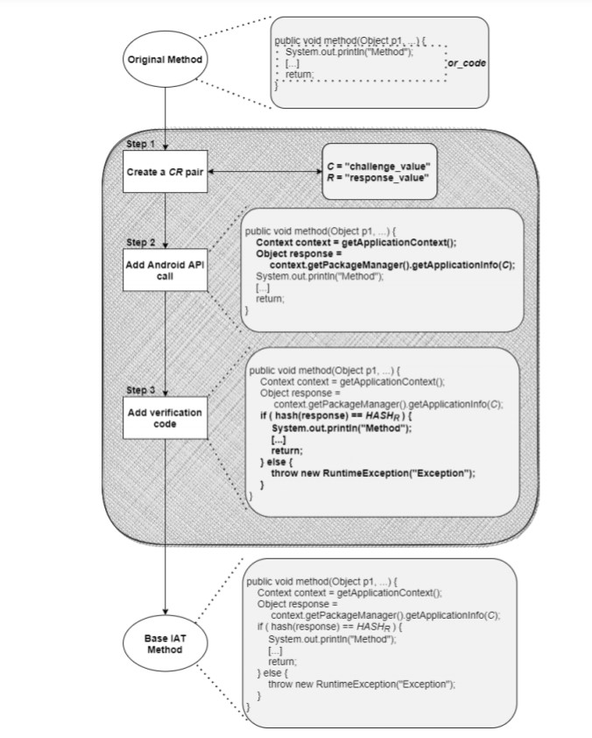
A Novel solution: MARVEL
MARVEL protects the application through 3 approaches:
Code Splitting
Base IAT (Interconnected Anti-Tampering Controls)
IAT with encryption
Evaluation and analysis of anti-repackaging techniques robustness in an Android virtual environment
Claudio Rimensi
10 di 15

Slide 11
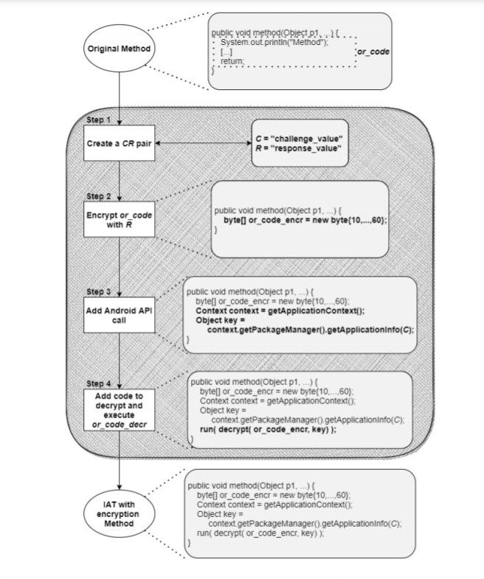
A Novel solution: MARVEL
MARVEL protects the application through 3 approaches:
Code Splitting
Base IAT (Interconnected Anti-Tampering Controls)
IAT with encryption
Evaluation and analysis of anti-repackaging techniques robustness in an Android virtual environment
Claudio Rimensi
11 di 15

Slide 12
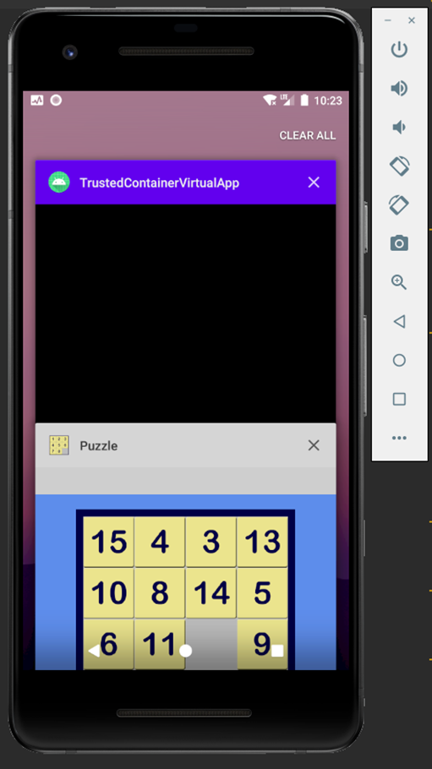
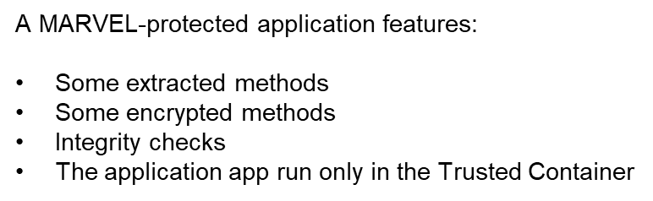

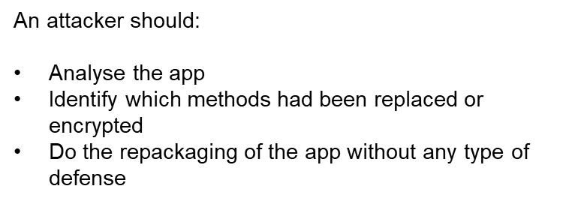
A novel solution to bypass MARVEL’s defense
Evaluation and analysis of anti-repackaging techniques robustness in an Android virtual environment
Claudio Rimensi
12 di 15

Slide 13

A novel solution to bypass MARVEL’s defense
Prior information:
puzzle.1_22 (https:/ /apkpure.com/it/puzzle/br.com.cjdinfo.puzzle)
Emulator x_86_64 with Android 8
The decrypt part was not implemented as the mode was similar to the extraction of methods
I used Frida as dynamic tools
STEP 1: Run Frida server on the emulator
STEP 2: Run omen to spawn the target process to get the PID of the Trusted Container
STEP 4: Run extraction to recover the original body methods
STEP 3: Run read_code_smali to get info about base IAT
STEP 5: Repackaging the apk
Evaluation and analysis of anti-repackaging techniques robustness in an Android virtual environment
Claudio Rimensi
13 di 15

Slide 14
A novel solution to bypass MARVEL’s defense
Apk works with
Trusted Container
Apk crash without
Trusted Container
Apk works without
Trusted Container
Evaluation and analysis of anti-repackaging techniques robustness in an Android virtual environment
Claudio Rimensi
14 di 15

Slide 15
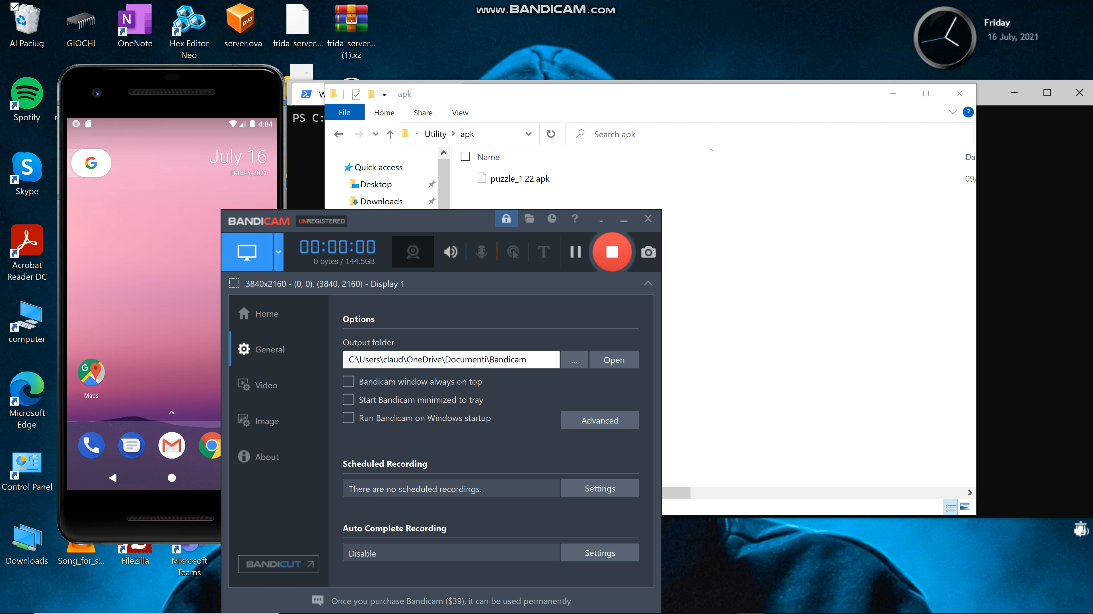
Practical demonstration
Evaluation and analysis of anti-repackaging techniques robustness in an Android virtual environment
Claudio Rimensi
15 di 15

Slide 16
Thanks for the attention

